Slide 1
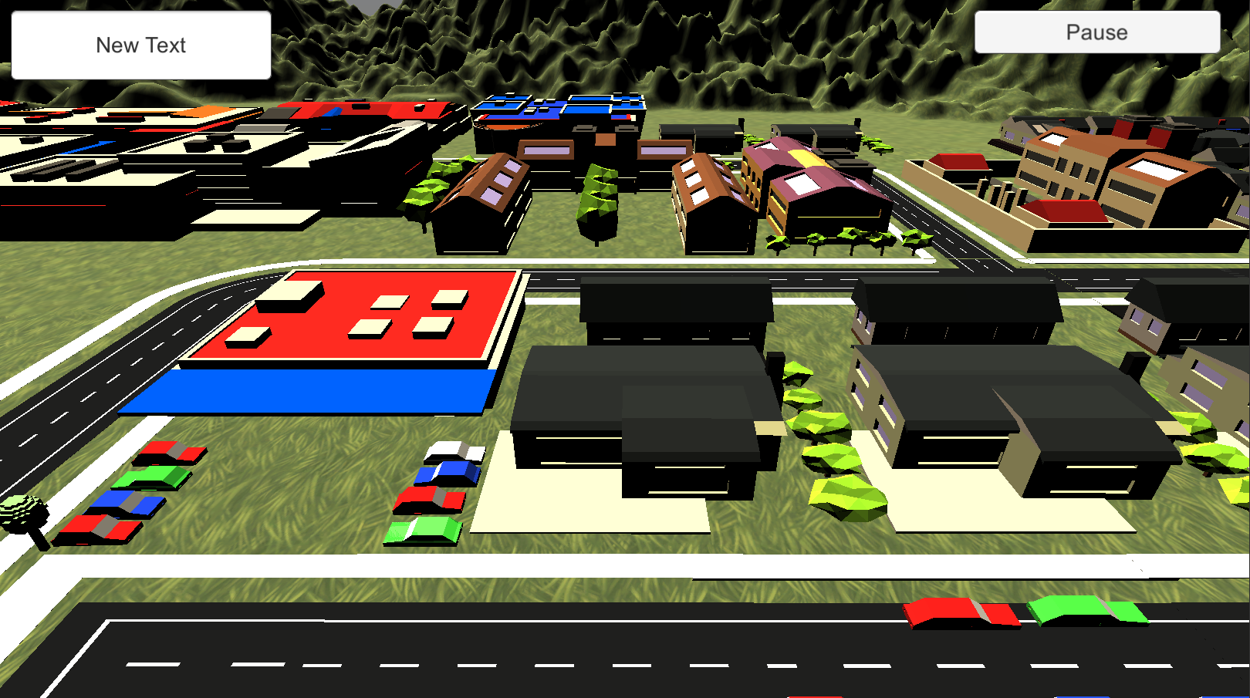






Player: Sam Score: 500

